Slide 1
Welcome!
Mentor Orientation 2013

Slide 2
Welcome & Introductions
Academy of Business
Mentor Orientation 2013

Slide 3
“None of us has gotten where we are solely by pulling ourselves up from our bootstraps. We got here because somebody...bent down and helped us.”
-Thurgood Marshall

Slide 4
The Bridge Builder by Will Allen Dromgoole
The builder lifted his old gray head.
“Good friend, in the path I have come,” he said,
“There followeth after me today
A youth whose feet must pass this way.
This chasm that has been naught to me
To that fair-haired youth may a pitfall be;
He, too, must cross in the twilight dim;
Good friend, I am building this bridge for him.”
An old man going a lone highway,
Came at the evening, cold and gray,
To a chasm vast and deep and wide,
Through which was flowing a sullen tide.
The old man crossed in the twilight dim --
The sullen stream had no fear for him;
But he turned when safe on the other side,
And built a bridge to span the tide.
“Old man,” said a fellow pilgrim near,
“You are wasting strength in building here.
Your journey will end with the ending day;
You never again will pass this way.
You’ve crossed the chasm, deep and wide,
Why build you the bridge at eventide?”

Slide 5
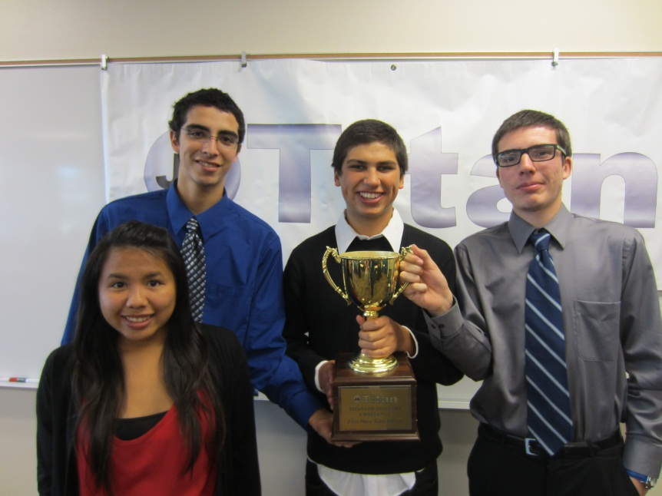
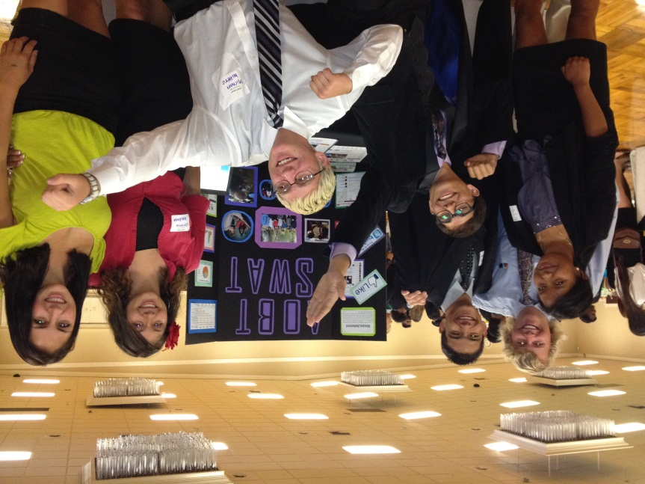
AcademyCHS.org
Small learning community
Business industry focus
130 students grades 10-12
6 teachers who work together
AOBT Foundation
Community involvement (mentorships, internships, guest speakers, fieldtrips, and more)
College & career prep
Integrated courses & projects
Family environment

Slide 6
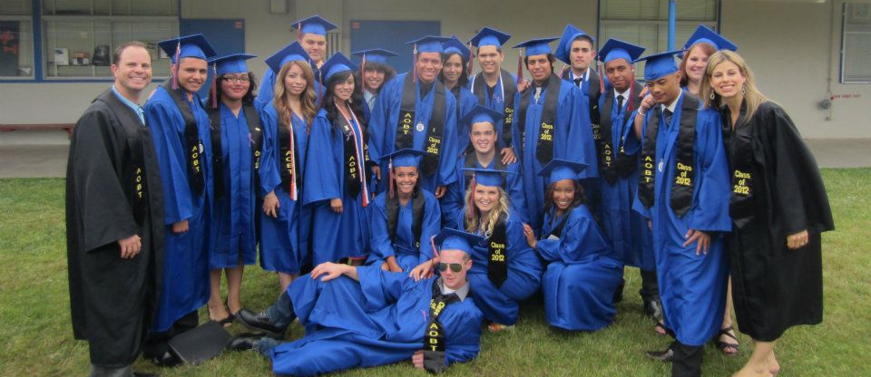
About Our Students
40% first in family to graduate high school
69% first in family to go to college
100% said, “I had a strong ability to communicate with interesting adults in my community.”

Slide 7
Student Speakers

Slide 8
Our Programs

Slide 9
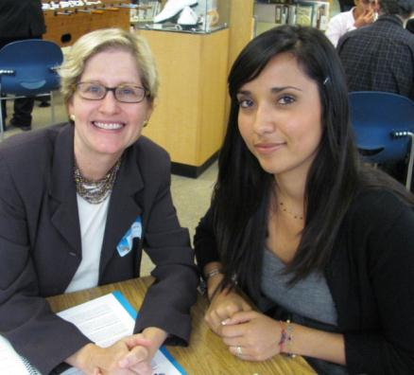
Contact & Communication
Program Coordinator: Liz Rush
erush@aobt.net
858-204-9363
(email and text preferred)
E-mail Mentor Lists
E-Calendar Invites for meetings
AcademyCHS.org
Mentor Handbooks

Slide 10
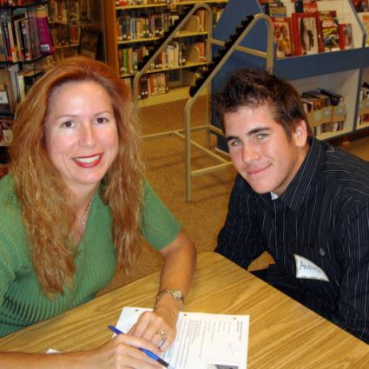
I. Objectives of Mentor Program
Role Models for our students
Build self-esteem & motivation
Career preparation
Community connections

Slide 11
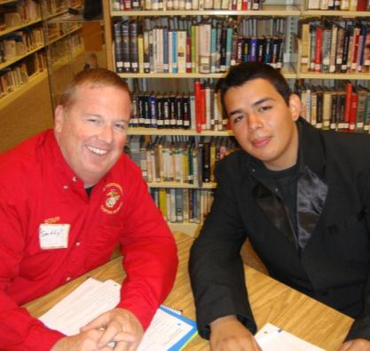
II. Defining the Mentor Experience
What is a mentor?
Benefits to mentees
Benefits to mentors
Who should be a mentor?
Responsibilities of a mentor

Slide 12
Commitment: You should have no problem committing to mentor if:
You can easily prioritize the monthly Thursday-morning mentor meeting without conflicts.
You can make a commitment to be on time at every single scheduled meeting.
Follow-through is one of your strengths; you can go above and beyond the required meetings.
You have the dedication and patience to help your student open up in conversation.
You will be available to communicate regularly with your mentee (once per week) via e-mail.
You are able to see the program through to completion.
Page

Slide 13
Commitment: You should think twice before committing to mentor if:
You are in the process of switching careers.
You foresee a major life change this year that will restrict your time (wedding, baby, lengthy vacation, etc.)
You plan to move out of San Diego in the next 9 months.
Your work requires you to travel unexpectedly for long periods of time.
Your schedule is very unpredictable and/or inflexible.
You can already see a conflict with two or more of the scheduled meeting days/times.

Slide 14
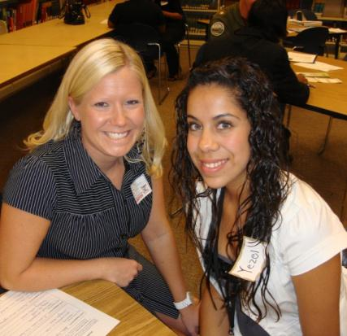
III. Effective Mentoring Relationships
Understand reluctance to trust
Mentoring = giving
Reassurance & Support
Problem-solving
Connect today and tomorrow
Capitalize on mentee interests
Don’t get too personal
Be “shock proof”
Realistic expectations

Slide 15
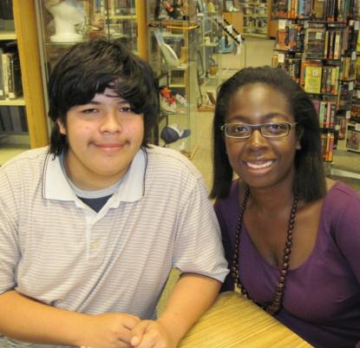
IV. Relationship Developmental Process
Stage 1: Building Trust
Stage 2: Reaching Goals & Getting Comfortable
Stage 3: Completing Mentorship

Slide 16
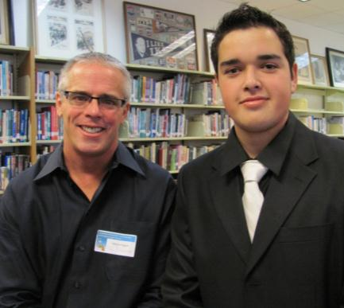
V. Helpful Mentor
Guidelines & Tips
Leading Scheduled Meetings
Dealing with Communication Barriers
Mentoring through e-mail
Optional mentor-student activities

Slide 17
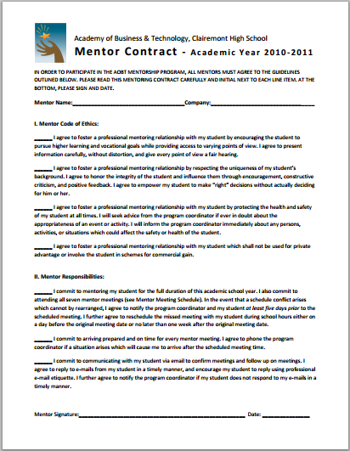
Mentoring Contract
Academic Year 2013-2014

Slide 18
Which Mentor Program?
10TH GRADE
11TH GRADE
Group mentoring, 4:1
Sophomore students
Focus on skills for success, good habits, academics
Group dynamic at meetings
Some meetings longer
Correspond with 3 students
Students younger, more impressionable
Experience with youth helpful
One-on-one mentoring
Junior students
Focus on goals, future, career-exploration & training
Personal dynamic at meetings
Job Shadow & Community service fieldtrips
Correspond more often with student
Student more mature, but more set in ways

Slide 19
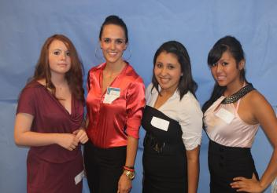
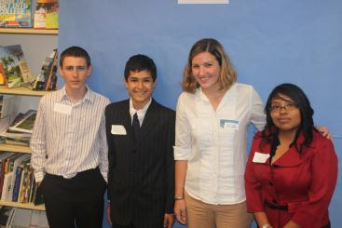
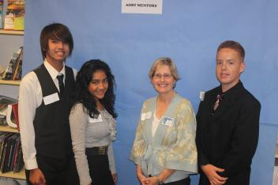
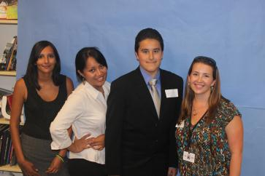
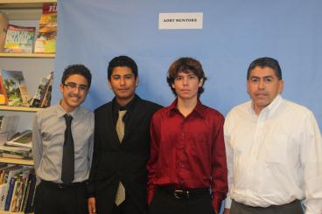
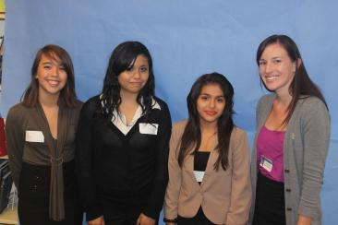
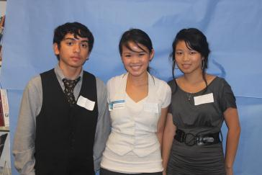
AOB 10th Grade Mentor Program
*Group Mentoring, 4:1
*Focus on Motivation

Slide 20
Scheduled Meetings – 10th Grade Program
MONTH | MEETING TOPIC | SCHEDULED DATE /TIME | LOCATION
Sept. | Mentor-Student Group Meeting 1: Introductions & Ice Breakers | Thur, Sept. 26, 2013 1:00 – 2:15 pm | Clairemont High Library
Oct. | Mentor-Student Group Meeting 2: Team Building, Goal Setting & Individual Check-Ins* | Thur, Oct. 24, 2013 1:00 – 3:00pm* | Clairemont High Library
Nov. | Mentor-Student Group Meeting 3: Mentor Team "Business" Olympics | Thur., Nov. 21, 2013 1:00 – 2:15 pm | Location chosen by mentor & students
Dec. | Mentor-Student Group Meeting 4: A Good Habit: Time Management | Thurs, Dec. 29, 2013 1:00 – 2:15 pm | Clairemont High Library
Jan. | Mentor-Student Group Meeting 5: Personal Business Plan & Academic Reflection | Thur, Jan. 14, 2013 1:00 – 2:15 pm | Clairemont High Library
Feb. | Mentor-Student Group Meeting 6: Group Mock Job Interviews & Check-Ins* | Thur., Feb. 20, 2014 1:00 – 3:00 pm* | Clairemont High Library
Mar. | Mentor-Student Group Meeting 7: Educational Group Fieldtrip Day | Choose day in March (not: 13th, 14th, 18th, 19th) Exact timeTBD by mentor | Clairemont High Gymnasium
Apr. | Mentor-Student Group Meeting 8: College Forum & Debrief | Thur, Apr. 17, 2014 1:00 – 2:15 pm | Clairemont High Library
May | Mentor-Student Group Meeting 9: Affirmations, Closing & Luncheon | Thurs, May 15, 2014 1:00 – 2:15 pm | Clairemont High Library
June | Mentor- Student Group Meeting 10: Performance Review of Personal Business Plan | Thur., Jun 12, 2014 9:30 am - 11:30 am | Clairemont High Library
Page

Slide 21
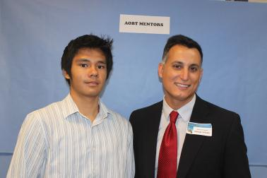
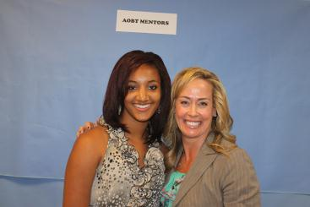
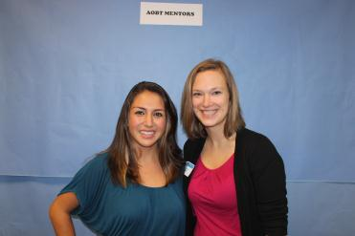
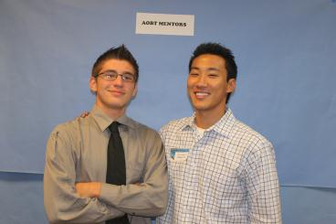
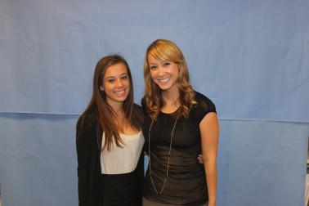
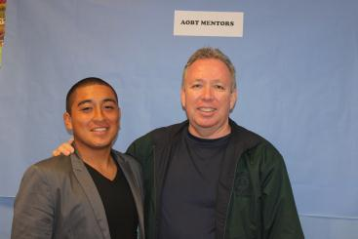
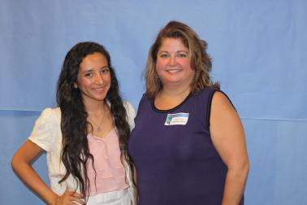
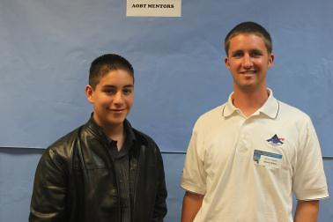
AOB 11th Grade Mentor Program
*One-on-One Mentoring
*Career Focus

Slide 22
Scheduled Meetings – 11th Grade Program
MONTH | MEETING TOPIC | SCHEDULED DATE /T | LOCATION
September | Mentor-Student Meeting 1: Intro, Ice Breakers, Self-Esteem & Goal Review | Thur., Sept. 26, 2013 12:00 pm – 1:15 pm | Clairemont High Library
October | Mentor-Student Meeting 2: Roadmap Mentor Interviews & Student Roadmaps | Thur., Oct. 24, 2013 12:00 – 1:15 pm | Clairemont High Library
November | Mentor-Student Meeting 3: Mentor "Business" Olympics | Thur., Nov. 21, 2013 12:00 – 1:15 pm | Clairemont High Outdoor soccer field
December | Mentor-Student Meeting 4: Job Shadow Fieldtrip Day | Choose day between Dec. 4 - Dec. 19 | Mentor's workplace or alternate location
January | Mentor-Student Meeting 5: Semester Reflection | Thur., Jan 16, 2014 12:00 – 1:15 pm | Clairemont High Library
February | Mentor-Student Meeting 6: Resume & Interview Techniques | Thur., Feb. 20, 2014 12:00 – 1:15 pm | Clairemont High Library
March | Mentor-Student Meeting 7: Future Planning | Thur., Mar. 20, 2014 12:00 – 1:15 pm | Clairemont High Library
April | Mentor-Student Meeting 8: Community Service Project FieldTrip | Fri., Apr. 17, 2014* | Off-campus fieldtrip;
May | Mentor-Student Meeting 9: Luncheon & Recognition | Thur., May 15, 2014 12:00 – 1:15 pm | Clairemont High Library

Slide 23
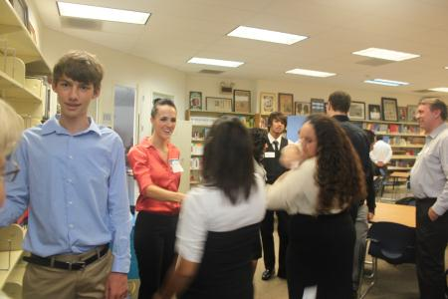
10th Grade Mentoring
Meeting 1: Introduction Personalities & Commonalities
Match Up Activity
Meet Your Mentor
Two-Minute Intros
Things We Have In Common
September

Slide 24
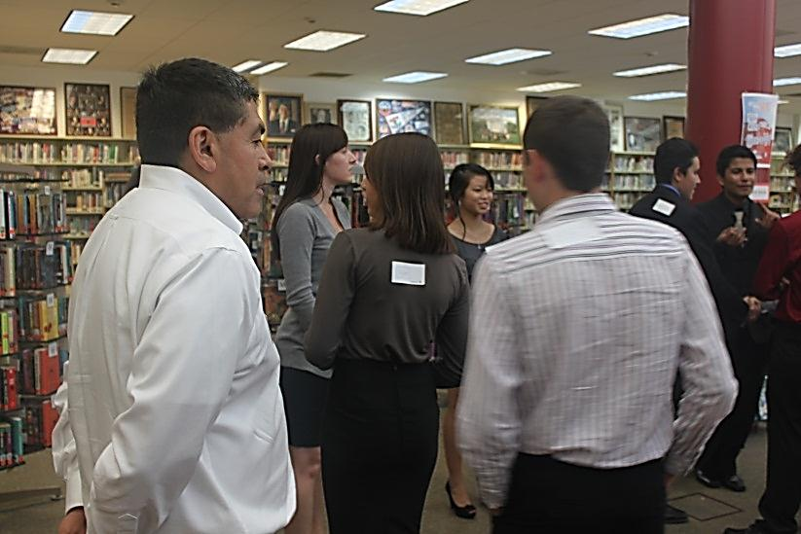
Guessing Groups Match Up
Theme on Mentor’s Back
Group #
(Mentor): Disney Characters
(student 1): Mickey Mouse
(student 2): Donald Duck
(student 3): Goofy
Topics/ Characters/ etc. on students’ backs
For 10th Grade Mentors Only

Slide 25
11th Grade Mentoring
Meeting 1: Introductions
Ice Breakers & Self-Esteem
Mentor Match-Up Activity
Mentor-Student Introductions
Get to Know Each Other
Self-Esteem Activity
September

Slide 26
Unique Fact Card Match Up
Your Mentor Info:
Mentor Name: __________________________________________________
Job Title:_______________________________________________________
Company/Organization:___________________________________________
Heard about AOBT from:___________________________________________
Unique Fact:_____________________________________________________
_______________________________________________________________
_______________________________________________________________
_______________________________________________________________
-Do NOT write your name on this
Write First and Last Name
Stick note to back of your index card
(see your profile)
-Be creative, original, specific
-Something interesting to break ice
-Example: I was bit by the state fish while snorkeling
on the Big Island of Hawaii.
For 11th Grade Mentors Only

Slide 27
10th Grade Mentoring
Meeting 2: Success, SMART Goals & Check-Ins
Secrets of Success Activity
Setting Goals the SMART Way
SMART Goals Action Plan Check-Ins
October

Slide 28
11th Grade Mentoring
Meeting 2: Roadmap Interview & SMART Goals
October
Mentor Roadmap: Student Interviews of Mentors
Student Roadmap: Setting SMART Goals
SMART Goal Action Plan

Slide 29
10th Grade Mentoring
Meeting 3:
Mentor Team Building Olympics
Fun team-building games
Mentor-student groups competing
Directed by staff
Dress comfortably
Not strenuous!
November

Slide 30
11th Grade Mentoring
Meeting 3:
Team-Building Olympics
November
Team Building Games
Tentatively Plan Job Shadow Fieldtrip

Slide 31
10th Grade Mentoring
Meeting 4: Time Management
Ice Breaker: My Pictures
How Do I Spend My Time? Activity
Backward Planning Activity
December

Slide 32
11th Grade Mentoring
Meeting 4:
Job Shadow Fieldtrip
Choose one day during two-week window
Mentor takes student to worksite (or alternate location)
Arrange logistics & transportation (Mentor Vehicle Form)
Student fills out Job Shadow Career Sheet
December

Slide 33
10th Grade Mentoring
Meeting 5:
Academic Reflection & Personal Business Plan
January
Ice-Breaker: Skittles Conversations
Catch-Up Time
Academic Reflection on Semester
Share Personal Business Plans

Slide 34
11th Grade Mentoring
Meeting 5:
Academic Reflection
January
Brain Teaser Competitions
Catch-Up Time
Academic Reflection on Semester

Slide 35
10th Grade Mentoring
Meeting 6:
Practice Job Interviews & Check-Ins
February
Ice Breaker: What I Wanted to Be When I Grew Up
Interview Tips
Practice Group Job Interview
Check-Ins: Feedback on Job App & Interview

Slide 36
11th Grade Mentoring
Meeting 6:
Resume & Interview Techniques
February
Catch-up and Updates
Review & Revise Resume
Interview Preparation & Practice

Slide 37
10th Grade Mentoring
Meeting 7:
Educational Group Fieldtrip
Choose one day during March
Choose a location related to college and/or career
Coordinate and schedule logistics with group
Arrange transportation (Mentor Vehicle Form)
Inform coordinator of details
March
Page

Slide 38
11th Grade Mentoring
Meeting 7:
Future Planning
Update on Student Goals
Future Plans Worksheet
College, Testing
Using Spring & Summer Breaks
Letter of Reference
March

Slide 39
10th Grade Mentoring
Meeting 8:
College Forum & Debrief
College Forum: Mentors as a panel
Discussion of Post-Secondary Academics
Set up for College Quest
April

Slide 40
11th Grade Mentoring
Meeting 8:
Community Service Project
Fieldtrip Day
Activity TBA
Mentors to carpool
Kick off to 11th Gr. Social Entrepreneur Project
April

Slide 41
10th Grade Mentoring
Meeting 9:
Closing & Luncheon
May
Thank-you Luncheon
Assessment of Year’s Progress
Future Outlook
Mentorship Program Feedback Form

Slide 42
11th Grade Mentoring
Meeting 9:
Recognition & Luncheon
May
Assessment of Year’s Progress
Closing: Goodbye, Recognition, Future Contact
Mentorship Program Feedback
Thank-you Luncheon

Slide 43
11th Grade Mentoring
Meeting 10:
Personal Business Plan
May
Assessment of Year’s Progress
Closing: Goodbye, Recognition, Future Contact
Mentorship Program Feedback
Thank-you Luncheon

Slide 44
10th Grade Mentoring
Meeting 10:
Personal Business Plan
June
Finals Presentations
Last Day of School

Slide 45
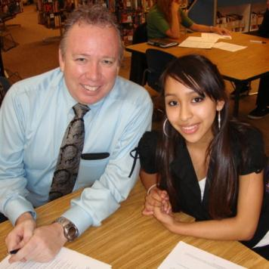
Final Steps:
AOB Mentor Contract
School Volunteer Application
Live Scan: Request to Conduct Volunteer Screening Form
Notecard for Matching
Student Preferences (Optional)

Slide 46
LiveScan Screening
OPTION 1:
To complete through the SDUSD Police Services LiveScan Department :
* Cleared prior to first mentor-student meeting on Sept 27.
* (If LiveScaned by SDUSD in last year, or employee, info should be on file.)
* No Fee
* SDUSD Police Services Office in University Heights, 4100 Normal St.
* Mon – Fri, Walk-ins: 8:30 am – 1pm / Appts.: 2 - 4:00 pm
* Take proper form of ID and Request to Conduct Volunteer Screening Form. To properly fill out this form:
Check “CATEGORY D – Volunteer Fingerprint” at the top
For “REQUESTING SCHOOL” write “Clairemont High”
For “VOL. COORDINATOR,” write “Liz Rush.”
* Say from “Liz Rush’s Mentor Program at Clairemont High”
* Helen Elhard, LiveScan Supervisor: helhard@sandi.net

Slide 47
LiveScan Screening
OPTION 2:
To complete through alternate LiveScan facility:
* Cleared prior to first mentor-student meeting on Sept 29.
* Fee varies according to facility
* Take proper form of ID and Request For LiveScan Form
* Use pre-filled form
* Return completed form to SDUSD Fingerprinting Office immediately upon completion so they finish the clearance process.
* Helen Elhard, LiveScan Supervisor: helhard@sandi.net

Slide 48
Thank You, Mentors!
It’s going to be a great year!
See you on Thursday, Sept. 27.

